Slide 1
GASP
Greedy Augmented Sequential Patterns
Eyal Shnarch
Ran Levy
Noam Slonim

Slide 2
Complex tasks demand complex linguistic features
Given many documents we can:
classify \ cluster them
with Naïve Bayes and simple BOW representation
very good in practice
Identify author
with simple features such as stop words and punctuations distribution
These simple linguistic features are not enough when:
dealing with complex linguistic phenomena
e.g., argumentation mining, textual entailment
the phenomenon is reflected in short texts

Slide 3
Unveil the underlying common structure
Topic: Open Primaries
Opponents often argue that the open primary is unconstitutional.
Topic: Affirmative Action
Prof. Smith suggested that affirmative action devalues the accomplishments of the chosen.
Topic: Freedom of Speech
The majority stated that the First Amendment does not guarantee the right to offend others.
[someone] [argue/suggest/state] [that]
[something related to the topic] [sentiment term]
Notes:
Is there a common part in these sentences?
Goal: Learn semantic patterns which reflect the commonality of given texts
Obviously BOW will not help here

Slide 4
Augment term with multiple attributes
redirect
domain knowledge injection
sentiment
named entity
is-a
syntactic relation
part-of-speech
Barack Obama
lexicon
no sentiment
Person
US president
object
NNP
Obama
topic word
no sentiment
----
citizen
subject
noun
voter
Notes:
What is the best generalization level
Attributes convey various types of information
GASP can systematically exploit a wide variety of information layers in a unified manner.
Its patterns go significantly beyond the patterns examined by previous works.

Slide 5
The GASP algorithm
Input:
Positive and negative examples of a target phenomenon
Output:
A ranked list of multilayered patterns indicative to the target phenomenon
single token
gaps are allowed
[adjective] [topic lexicon match] [noun, @obj]
attribute set
attribute

Slide 6
The GASP algorithm
Build a multilayered representation for each input example
Extract all (unigram) attributes found in the input examples
Choose top K
filter infrequent
rank by correlation with label (info gain)
avoid redundancy (normalized mutual information)
Grow patterns
Right: add another feature set to the right of the seed
Inside: add another feature into the feature set of the seed
Repeat 3-4 until reaching a maximal size of patterns
p: [SENTIMENT] [noun] a: obj
[SENTIMENT] [noun] [obj]
[SENTIMENT] [noun, obj]
Notes:
infrequent attributes: less than 0.5% in all examples
avoid redundancy: an attribute is not correlated with any other higher ranked attribute

Slide 7
Back to our example
[someone] [argue/suggest/state] [that]
[something related to the topic] [emotional term]
Topic: Open Primaries
Opponents often argue that the open primary is unconstitutional.
Topic: Affirmative Action
Prof. Smith suggested that affirmative action devalues the accomplishments of the chosen.
Topic: Freedom of Speech
The majority stated that the First Amendment does not guarantee the right to offend others.
[noun] [hyponym of express] [that] [noun, TOPIC] [SENTIMENT]
Notes:
Is there a common part in these sentences?
Goal: Learn semantic patterns which reflect the commonality of given texts
Obviously [BOW will not help here

Slide 8
GASP characters
Gaps are allowed – pattern is match within a window
Patterns for the negative class
Simultaneously considers all layers for each word
Generates cross-layered patterns
Between words
And within a single word: can learn that the best generalization for it is to combine multiple layers
GASP is a research tool that unveils common structures in your data

Slide 9
Experimental results

Slide 10
Data sets
Claim sentence detection
Evidence of type expert detection
Evidence of type study detection
[Aharoni et al. 2014 ; Levy et al., 2014 ; Rinnot et al., 2015]
Data set | Size | % positives
(a) Claim sentence | 80.5K | 2.5
(b) Evidence of type expert | 55.6K | 4.0
(c) Evidence of type study | 31.9K | 3.7

Slide 11
Baselines
All true - predicts each candidate as positive (reflects the low prior of positives)
Naïve Bayes over Bag-Of-Words representation
Basic patterns – Stop words, POS tags and TOPIC
CNN
GASP alphabet
GASP – a single (sub-optimal) configuration for all tasks
minimal frequency threshold = 0.005, correlation threshold = 0.5
alphabet size = 100, number of patterns in the output = 100
maximal pattern length = 5
window size = 10 for tasks (a), and = 20 for tasks (b) and (c)
since evidence texts are typically longer than claim texts
Notes:
To demonstrate robustness
Each attribute/pattern is a binary feature for LR classifier

Slide 12
Results
**
*
**
*
**
*
*
Notes:
Macro-averaged precision results for GASP over 3 argumentation mining tasks.
Significant results in comparison to GASP alphabet/CNN are marked with **/* respectively (paired t-test with p<0.01/0.02 respectively).

Slide 13
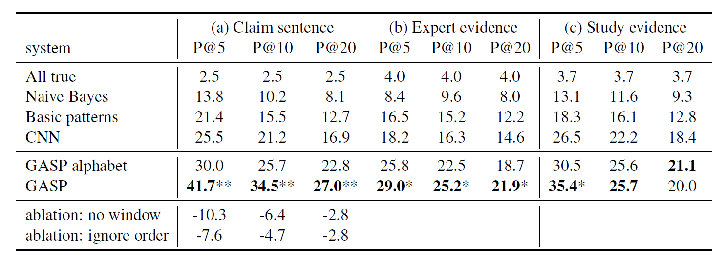
Results
Notes:
Macro-averaged precision results for GASP over 3 argumentation mining tasks.
Significant results in comparison to GASP alphabet/CNN are marked with **/* respectively (paired t-test with p<0.01/0.02 respectively).

Slide 14
Comparing to full-fledged argumentation mining systems
**
Notes:
Comparing GASP to the claim detection system of Levy et al. (2014).
Significant results in comparison to Levy14-rep are marked by **/* (paired t-test with p<0:02=0:05 respectively).

Slide 15
GASP in the wild - Identify compliance sentences in contracts

Slide 16
Same GASP new task
Completely new task from another domain – Identify compliance sentences in contracts
Off the shelf usage – only general NLP attribute layers
Gasp provides insights when addressing a novel task
Match results
[noun.person],[shall],[VB],[the],[IN]
[shall],[the],[leader-n-1]
Notes:
GASP patterns are easy to interpret (in contrast to Deep Learning or LDA).
They provide the researcher with insights regarding the examined target phenomenon.
Insights that can be integrated back to the analysis by considering additional attributes that GASP can explore in subsequent runs.
Thus, GASP can significantly expedite the research process, especially when addressing novel tasks.

Slide 17
If time permits…

Slide 18
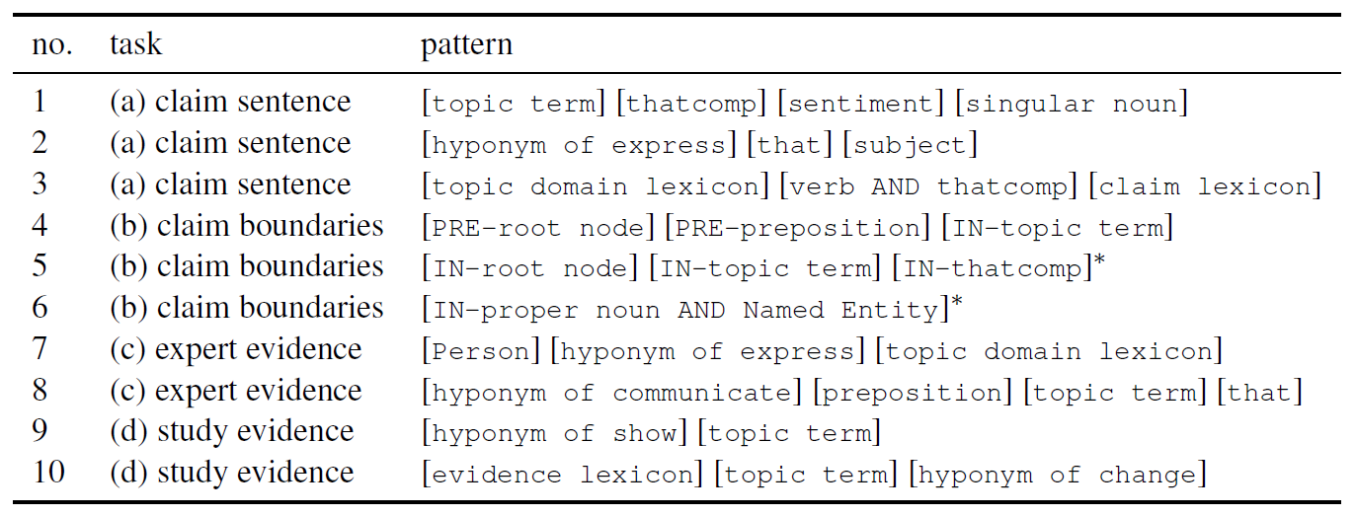
Patterns examples
* These are patterns for the negative class
Notes:
second element of must be a verb which is related to its parent in the parse tree of the sentence with the thatcomp relation
The meaning of the pattern in row 4 is that the root of the parse tree of the sentence and a preposition should be matched before the claim boundaries, i.e., before the claim part, while a topic term should appear inside it.
Rows 5 and 6 depict negative patterns, patterns whose match in the sentence reflects that there is no claim in those boundaries. Therefore, according to the pattern in row 5, matching the root node inside the candidate boundaries together with topic term and thatcomp, is indicative that this candidate is not a claim part. Similarly, row 6 reveals that a proper noun which is also a named entity should not appear inside the claim boundaries.
It is not surprising to see that many evidence sentences of type Expert has a Person named entity at their beginning (as reflected in the pattern of row 7), and that verbs which are hyponyms of express or communicate appear a lot in such evidence
texts.
For Study evidence texts, the patterns in rows 9–10 show us that hyponyms of show and change can be indicative.

Slide 19
Diffs from prior pattern works
Mainly identify pairs of word that are related by a specific relation
WordNet: Hearst, 92; Berland and Charniak, 1999; Girju et al., 2006
RE: Brin, 1998; Ravichandran and Hovy, 2002; Etzioni, 2004; Pasca et al., 2006
GASP identifies texts in which a subtle target phenomenon occurs
Highly lexicalized, composed of words and POS tags
Riloff et al., 2003: [subj] [was] [asked]
Snow et al., 2004 (syntactic relation)
GASP patterns are composed of a rich and varied alphabet of features with a high degree of freedom in features combinations
Patterns of consecutive words
GASP allows gaps which makes its patterns more powerful
Only positive patterns
GASP can learn patterns for the negative class

Slide 20
Find a common pattern
One of the most common criticisms of video games is that they increase the violent tendencies among youth.
Topic: the sale of violent video games to minors
Supporters of the ban state that boxing is the only sport where hurting the other athlete is the goal.
Topic: boxing
Proponents of the nuclear peace argue that controlled nuclear proliferation may be beneficial for inducing stability.
Topic: nuclear weapon
One of the most common criticisms of video games is that they increase the violent tendencies among youth.
Topic: the sale of violent video games to minors
Supporters of the ban state that boxing is the only sport where hurting the other athlete is the goal.
Topic: boxing
Proponents of the nuclear peace argue that controlled nuclear proliferation may be beneficial for inducing stability.
Topic: nuclear weapon
[TOPIC] [@thatcomp] [SENTIMENT] [NN]
Notes:
NN – singular noun
thatcomp - complement of the subordinate conjunction sense of `that’

Slide 21
Find a common pattern
Purists argue that any social system that allocates resources based on chance is one that is corrupt.
Topic: gambling
Supports declare that multiculturalism helps in bringing together immigrants and minorities in the country.
Topic: multiculturalism
Manley said on CBC Radio that he believed that hereditary succession was outdated.
Topic: monarchy
Purists argue that any social system that allocates resources based on chance is one that is corrupt.
Topic: gambling
Supports declare that multiculturalism helps in bringing together immigrants and minorities in the country.
Topic: multiculturalism
Manley said on CBC Radio that he believed that hereditary succession was outdated.
Topic: monarchy
[<express] [that] [@subj]
Notes:
NN – singular noun
thatcomp - complement of the subordinate conjunction sense of `that’

Slide 22
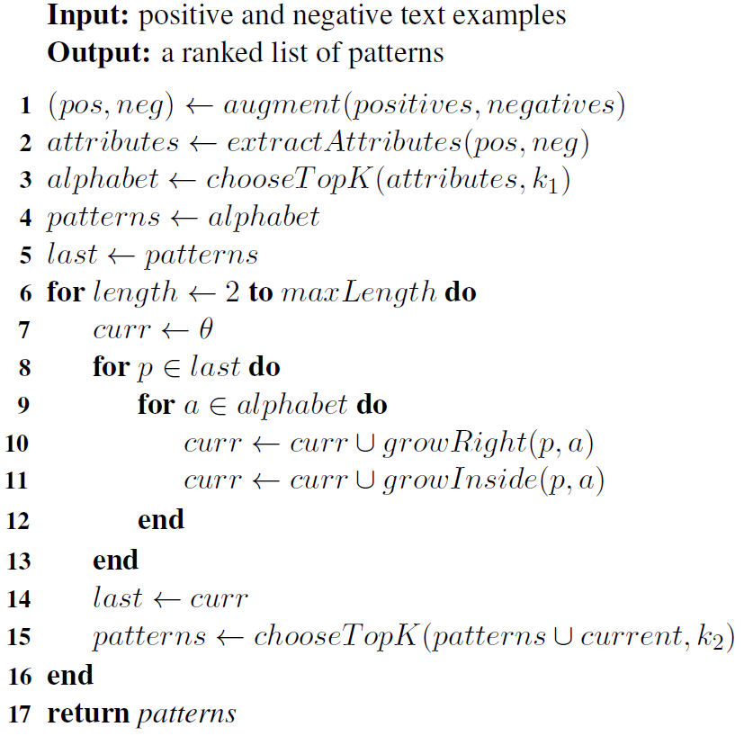
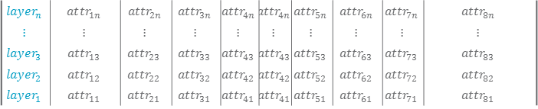
The GASP algorithm
$$layer_{n}$$ | $$at{tr}_{1n}$$ | $$at{tr}_{2n}$$ | $$at{tr}_{3n}$$ | $$at{tr}_{4n}$$ | $$at{tr}_{4n}$$ | $$at{tr}_{5n}$$ | $$at{tr}_{6n}$$ | $$at{tr}_{7n}$$ | $$at{tr}_{8n}$$
$$⋮$$ | $$⋮$$ | $$⋮$$ | $$⋮$$ | $$⋮$$ | $$⋮$$ | $$⋮$$ | $$⋮$$ | $$⋮$$ | $$⋮$$
$$layer_{3}$$ | $$attr_{13}$$ | $$attr_{23}$$ | $$attr_{33}$$ | $$attr_{43}$$ | $$attr_{43}$$ | $$attr_{53}$$ | $$attr_{63}$$ | $$attr_{73}$$ | $$attr_{83}$$
$$layer_{2}$$ | $$attr_{12}$$ | $$attr_{22}$$ | $$attr_{32}$$ | $$attr_{42}$$ | $$attr_{42}$$ | $$attr_{52}$$ | $$attr_{62}$$ | $$attr_{72}$$ | $$attr_{82}$$
$$layer_{1}$$ | $$attr_{11}$$ | $$attr_{21}$$ | $$attr_{31}$$ | $$attr_{41}$$ | $$attr_{41}$$ | $$attr_{51}$$ | $$attr_{61}$$ | $$attr_{71}$$ | $$attr_{81}$$
Opponents often argue that the open primary is unconstitutional
filter infrequent attributes
rank by correlation with label (info gain)
avoid redundancy (normalized mutual information)
Alphabet:
p: [SENTIMENT] [noun]
a: obj
growRight: [SENTIMENT] [noun] [obj]
growInside: [SENTIMENT] [noun, obj]
1 | CLAIM LEXICON | 9 | MD | 17 | Named Entity
2 | @thatcomp | 10 | <express:v:2 | 18 | adj.all
3 | TOPIC | 11 | CD | 19 | @auxcomp
4 | ANY TOPIC | 12 | noun.attribute | 20 | LOCATION
5 | SENTIMENT | 13 | <attribute:n:2 | 21 | IN
6 | VBZ | 14 | <state:n:2 | 22 | <act:n:2
7 | <present:v:2 | 15 | @obj | 23 | noun.act
8 | noun.state | 16 | RB | 24 | TOPIC LEXICON
Notes:
UPPER CASE – lexicon match
UPPER CASE ITALIC – POS tags
BOLD - topic match
@ - syntactic relation
< - hyponyms of
pos.word - WN super class
VBZ : Verb, 3rd person singular present)
MD : modal
CD : cardinal number
RB : adverb
IN : Preposition or subordinating conjunction
thatcomp - complement of the subordinate conjunction sense of `that’

